Slide 1
CPSC 583 Expert Systems Design Theory
Dr. Anand Panangadan
apanangadan@fullerton.edu

Slide 2
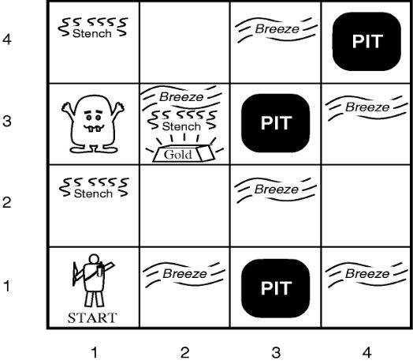
Propositional logic review
Symbolic logic for manipulating propositions
Develop a propositional logic system to decide where to move
What variables?
How to represent:
S11 = None ⇒ S12 = Safe ∧ S21 = Safe
How many rules?

Slide 3

Predicate Calculus/First Order Logic (FOL)
In addition to propositions, FOL provides:
Variables
Represent objects in the world
x, y
Functions
father-of(Mary) = John
Function input and output are objects
Predicates
Represent relationships between objects
father-of (Mary, John)
father-of (x, y) $⇒$child(y,x)
Predicate is either True or False

Slide 4
Building a FOL sentence
Constant symbols correspond to objects (“individuals”) in the Universe
E.g., Today, Mary
Convention: begin with a Capital letter
Variable symbols represent one of the objects
E.g., x, y, z
Convention: use small letters
Function symbols
E.g., mother-of (Bill); maximum-of (x,y)

Slide 5
Building a FOL sentence
A function expression consists of a function symbol of arity n, followed by n terms
mother-of(mother-of(joe))
maximum(maximum(7, 18), add_one(18))
Arity: number of input parameters
A term is either a constant, variable, or function expression.
color_of(house_of(neighbor(Joe)))
house_of(x)

Slide 6
Building a FOL sentence
A term is either a constant or variable
Can also be a function expression
color_of(house_of(neighbor(Joe)))
house_of(x)

Slide 7
Building a FOL sentence
Predicate symbols
Represent a specific relationship between objects
An atomic sentence is a predicate symbol of arity n, followed by n terms
father-of (Mary, John)
The truth values, True and False, are also atomic sentences.

Slide 8
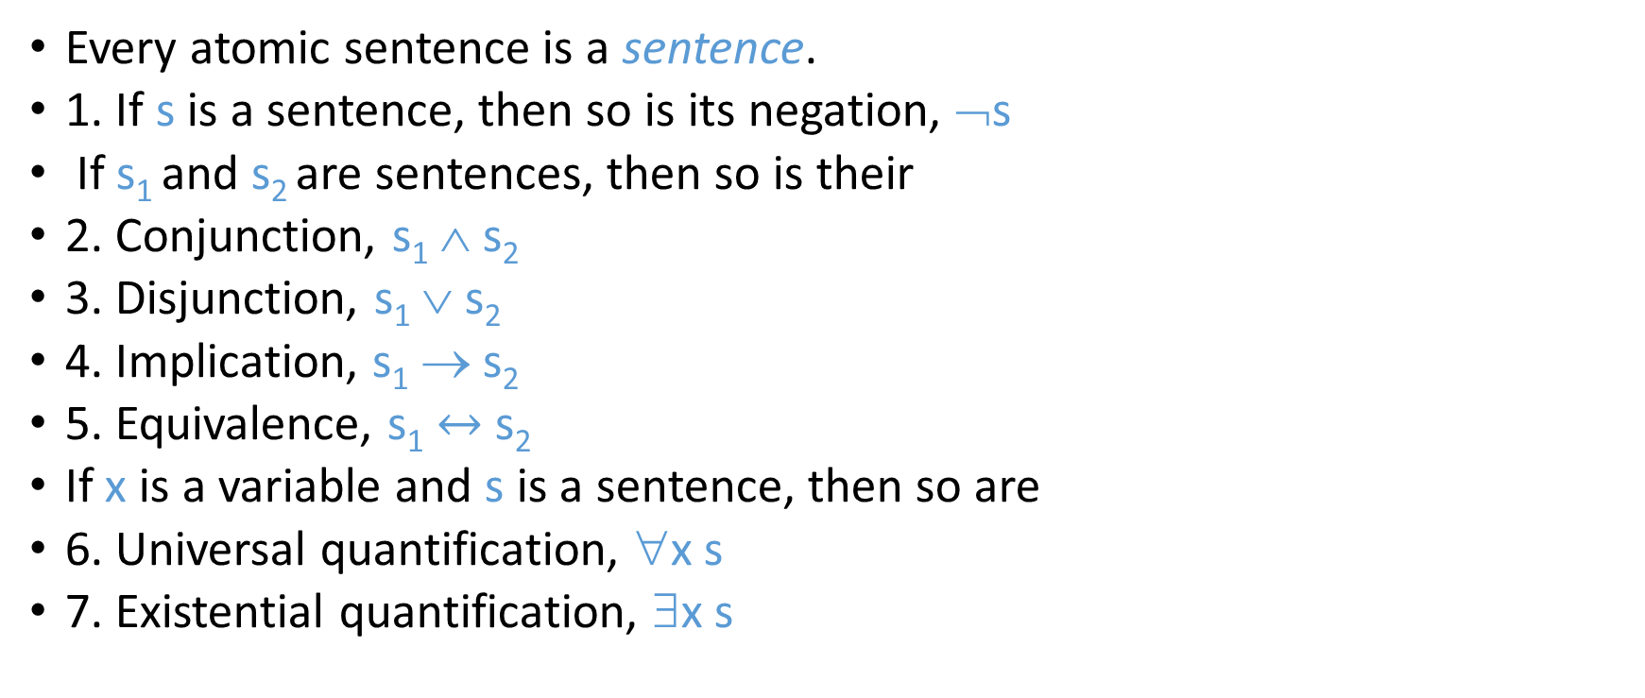
Building a FOL sentence
Every atomic sentence is a sentence.
1. If s is a sentence, then so is its negation, ¬s
If s₁ and s₂ are sentences, then so is their
2. Conjunction, s₁ ∧ s₂
3. Disjunction, s₁ ∨ s₂
4. Implication, s₁ → s₂
5. Equivalence, s₁ $↔$ s₂
If x is a variable and s is a sentence, then so are
6. Universal quantification, ∀x s
7. Existential quantification, ∃x s

Slide 9
Difference between sentences and terms
Logic sentences evaluate to True or False
Functions evaluate to objects
Functions are not atomic sentences
∃x mammal(x) ∧ lays-eggs(x)
Predicate
symbol
term (constant)

Slide 10
Quantifiers
Universal quantification
∀x P(x) means that P holds for all values of x in the domain associated with that variable
E.g., ∀x dolphin(x) → mammal(x)
Existential quantification
∃x P(x) means that P holds for some value of x in the domain associated with that variable
E.g., ∃ x mammal(x) ∧ lays-eggs(x)
Permits one to make a statement about some object without naming it

Slide 11
Universal quantifiers
“All students are smart”
Define predicates: student(x), smart(x)
∀x student(x)∧smart(x)
or
∀x student(x) → smart(x)
Universal quantifiers are often used with → (implies) to form “rules”:
∀x student(x) → smart(x) means “All students are smart”
Universal quantification is rarely used to make statements about every individual in the world:
∀x student(x)∧smart(x) means “Everyone in the world is a student and is smart”

Slide 12
Existential quantifiers
“There is a student who is smart”
Predicates: student(x), smart(x)
∃x student(x) ∧ smart(x)
or
∃x student(x) → smart(x)
Existential quantifiers are usually used with ∧(and) to specify a list of properties about an individual:
∃x student(x) ∧ smart(x) means “There is a student who is smart”
A common mistake:
∃x student(x) → smart(x) to represent “There is a student who is smart”
Why? (what happens when there is a person who is not a student?)

Slide 13
Quantifier Scope
Switching the order of universal quantifiers does not change the meaning:
∀x∀y P(x,y) ↔ ∀y∀x P(x,y)
Can switch the order of existential quantifiers:
∃x∃y P(x,y) ↔ ∃y∃x P(x,y)
Switching the order of universals and existentials does change meaning:
∀x ∃f food(f) ∧ likes (x,f) “Everybody likes some food”
∃f ∀x food(f) ∧ likes (x,f) “There is a (one specific) food that everyone likes”

Slide 14

Connections between All and Exists
Rewrite sentences involving ∀ and ∃ using De Morgan’s laws:
∀x P(x) ↔ $¬$∃x $¬$P(x)
∃x P(x) ↔ $¬$∀x $¬$P(x)

Slide 15
Translating English to FOL
Every gardener likes the sun.
∀x gardener(x) → likes(x,Sun)
You can fool some of the people all of the time.
∃x ∀t person(x) ∧time(t) → can-fool(x,t)
You can fool all of the people some of the time.
∀x ∃t (person(x) → time(t) ∧can-fool(x,t))
∀x (person(x) → ∃t (time(t) ∧can-fool(x,t)))
All purple mushrooms are poisonous.
∀x (mushroom(x) ∧ purple(x)) → poisonous(x)
No purple mushroom is poisonous.
¬∃x purple(x) ∧ mushroom(x) ∧ poisonous(x)
∀x (mushroom(x) ∧ purple(x)) → ¬poisonous(x)
There are exactly two purple mushrooms.
∃x ∃y mushroom(x) ∧ purple(x) ∧ mushroom(y) ∧ purple(y) ^ ¬(x=y) ∧ ∀z (mushroom(z) ∧ purple(z)) → ((x=z) ∨ (y=z))
Clinton is not tall.
¬tall(Clinton)
Every city has a dogcatcher who has been bitten by every dog in town.
∀T ∃C ∀D city(C) → ( dogcatcher(C,T) ∧ (dog(D) ∧ lives-in (D, T) → bit (D, C)) )

Slide 16
Translating English to FOL
Predicates
tall(x)
gardener(x)
likes(x, y)
mushroom(x)
purple(x)
poisonous(x)
teacher(x)
time(t)
can-fool(x,t)
wears-shorts(x)
wears-tshirt(x)

Slide 17
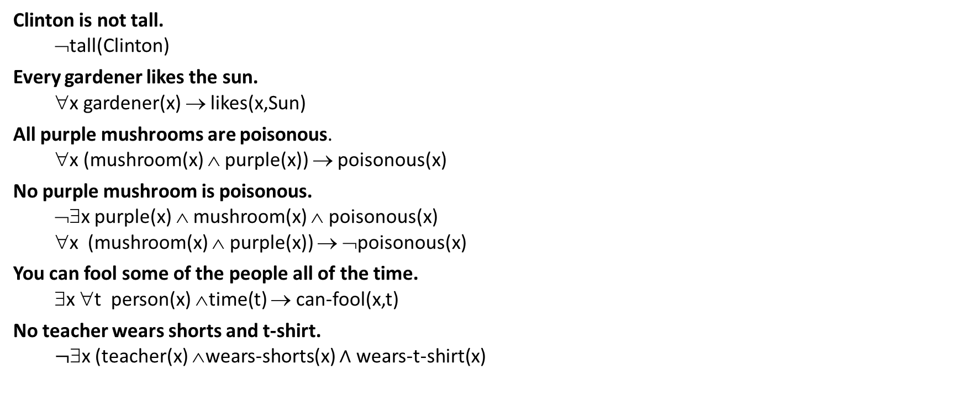
Translating English to FOL
Clinton is not tall.
¬tall(Clinton)
Every gardener likes the sun.
∀x gardener(x) → likes(x,Sun)
All purple mushrooms are poisonous.
∀x (mushroom(x) ∧ purple(x)) → poisonous(x)
No purple mushroom is poisonous.
¬∃x purple(x) ∧ mushroom(x) ∧ poisonous(x)
∀x (mushroom(x) ∧ purple(x)) → ¬poisonous(x)
You can fool some of the people all of the time.
∃x ∀t person(x) ∧time(t) → can-fool(x,t)
No teacher wears shorts and t-shirt.
$¬$∃x (teacher(x) ∧wears-shorts(x) $∧$ wears-t-shirt(x)

Slide 18
Inference in propositional logic
How to prove conclusion is valid?
Truth table
Every case where the premise is true, conclusion must also be true
Proof by rules of inference
Resolution refutation algorithm
How to prove conclusion is invalid?
Truth table
Show one case where the premise is true, conclusion must also be true
Proof by rules of inference
Resolution refutation algorithm

Slide 19
Inference in propositional logic
How to prove conclusion is valid?
Truth table
Every case where the premise is true, conclusion must also be true
Proof by rules of inference
Resolution refutation algorithm
How to prove conclusion is invalid?
Truth table
Show one case where the premise is true, conclusion must also be true
Proof by rules of inference
Resolution refutation algorithm

Slide 20
Inference in predicate logic
How to prove conclusion is valid?
Truth table
Every case where the premise is true, conclusion must also be true
Proof by rules of inference
Resolution refutation algorithm
How to prove conclusion is invalid?
Truth table
Show one case where the premise is true, conclusion must also be true
Proof by rules of inference
Resolution refutation algorithm

